Slide 1
Tableau
Presented by
BAVIRISETTY Sathvik(104838172)
Prudhvi mulukutla(104710597)

Slide 2
WHAT ARE WE GOING TO PRESENT?
INTRODUCTION TO TABLEAU
CONNECTING TO DATA
VISUAL ANALYTICS
DASHBOARD AND STORIES
CALCULATIONS
MAPPING TABLEAU

Slide 3
WHAT IS TABLEAU?
WE NEED KNOW TWO IMPORTANT QUESTIONS
WHAT IS DATA VISUALIZTION?
WHY IS DATA VISUALIZTION IMPORTANT?

Slide 4
WHAT IS DATA VISUALIZATION?
DATA VISUALIZATIONS IS THE PROCESS OF DESCRIBING INFORMATION THROUGH VISUAL RENDERING.
WHY IS DATA VISUALIZTION IMPORTANT?
TECHNOLOGY ADVANCES HAS MADE DATA VISUALIZATION MORE PREVALENT AND POWERFUL THAN EVER BEFORE.
BUSINESS PURPOSE.

Slide 5
WHAT IS TABLEAU?
Tableau is ground breaking data visualization software created by Tableau Software.
Tableau connects easily to nearly any data source
Tableau allows for instantaneous insight by transforming data into interactive visualizations called dashboards.

Slide 6
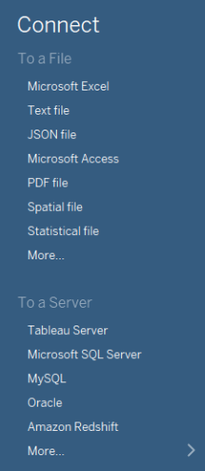
CONNECTING TO DATA
TABLEAU CAN BE CONNECTED TO :
LOCAL FILES (EXCEL, JSON)
SERVER (ORACLE, AMAZON REDSHIFT)
CLOUD
A WORK BOOK CAN HAVE MULTIPLE DATA SOURCE . WE CAN CONNECT TO A
LOCALLY SAVED EXTRACT OR TO A DATA SOURCE.

Slide 7
DATA Preparation
DATA INTERPRETER
PIVOT
SPLIT
CUSTOM SPLIT

Slide 8
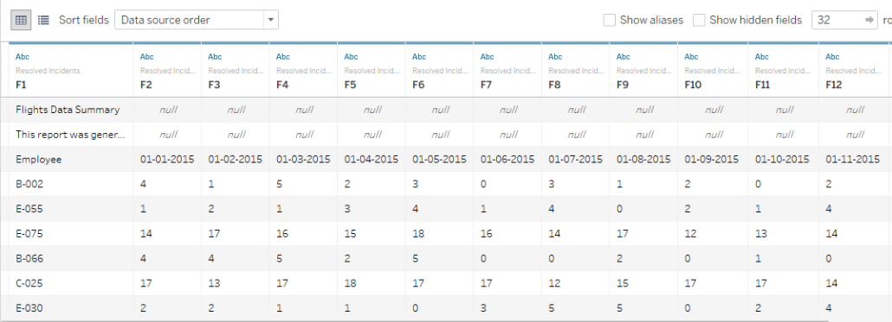
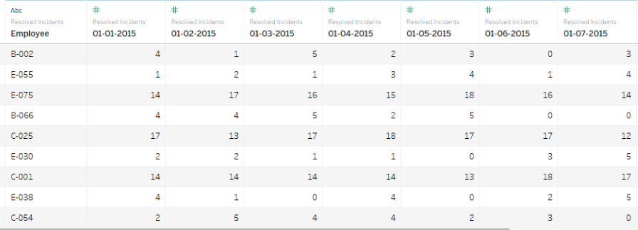
USING DATA INTERPRETER
MEANINGFUL
DELETE UNUSED ROWS AND CLOUMNS
HEPLS IN PDF FILES

Slide 9
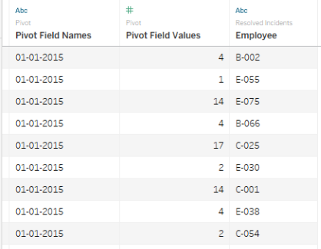
USING PIVOT

Slide 10
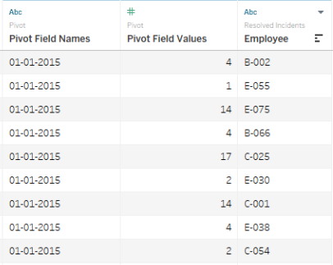
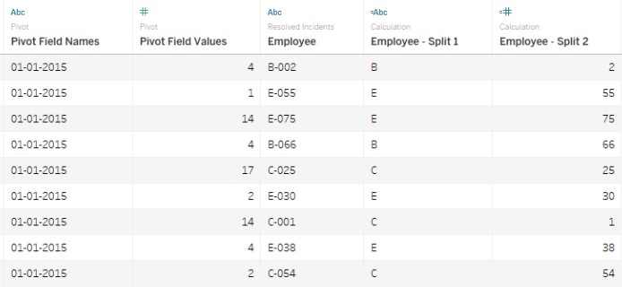
USING SPLIT

Slide 11
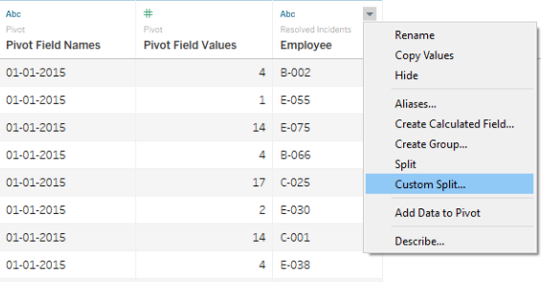
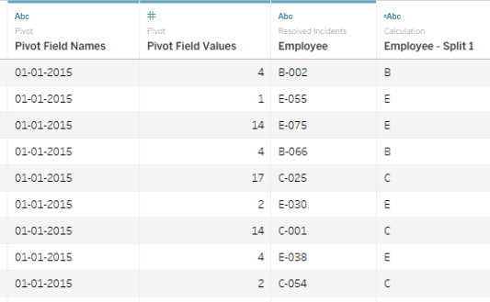

USING CUSTOM SPLIT

Slide 12
Cross Database join
Connect the data from two different sources by the same field name and join them and make a single table. The processed data can be saved and published.
It joins in a row level.
Data Blending
Connects the data from different sources and can perform the result on their database and can aggregate the result. We can even define the relationship between the fields.

Slide 13
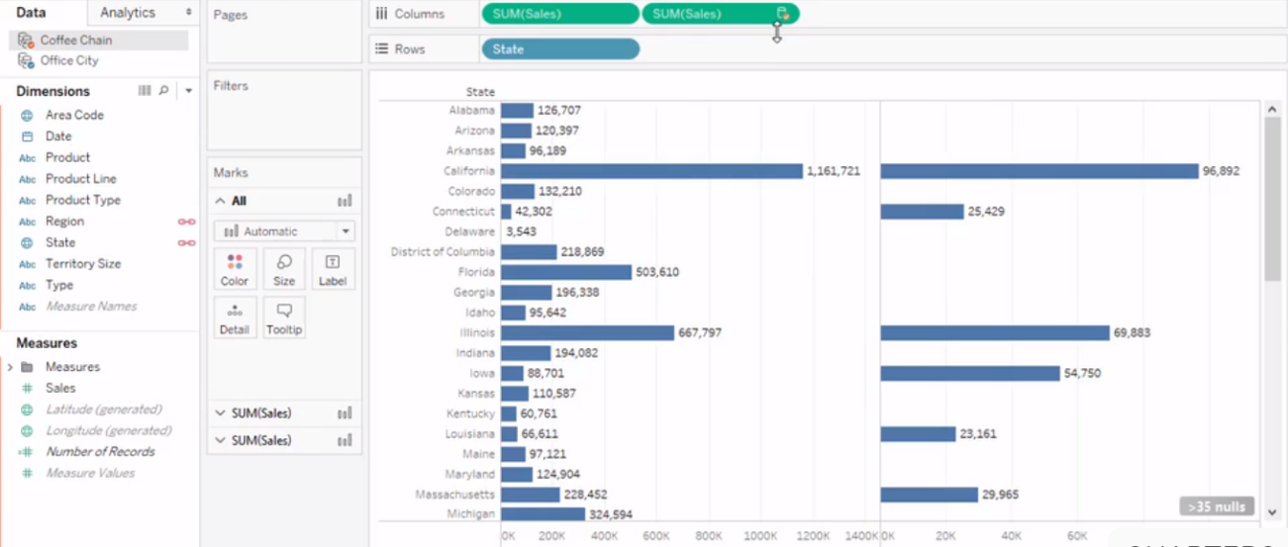

Slide 14
VISUAL ANALYTICS
Drill Down(you can drill down year to quarters)
Sorting(sort the sum ascending or descending)
Grouping(you can group the data to what it belongs)
Sets(you can create sets from the sheet by like high priority or low priority)

Slide 15
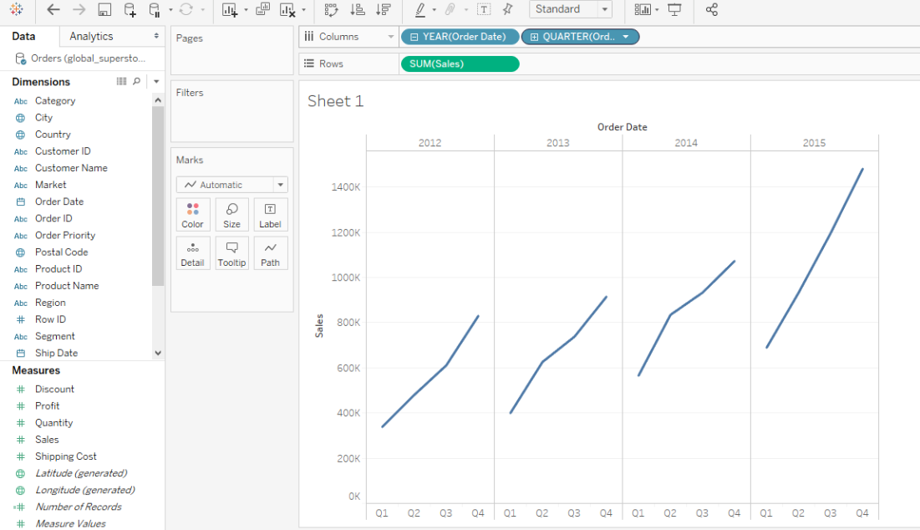
Drill Down

Slide 16
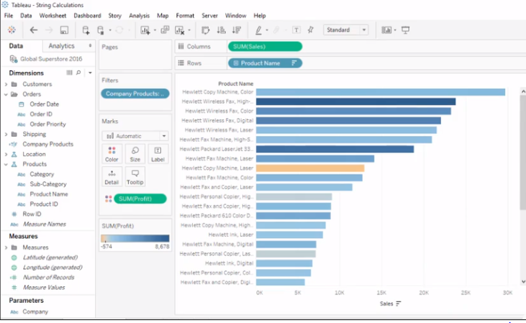
Sorting

Slide 17
WHAT IS DASHBOARD?
Powerful tool for mixing multiple views in a unique one
Allow us to create interactive and common filters for all the sheets grouped
Excellent tool for generic views

Slide 18
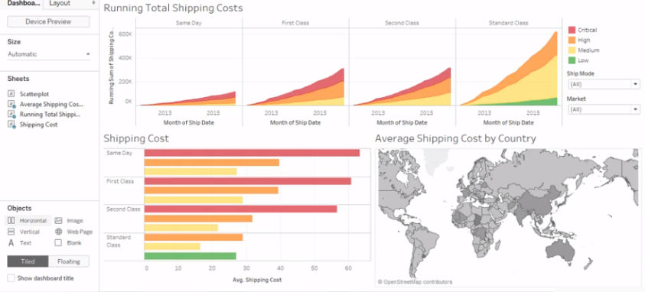

Slide 19
WHAT IS A STORY?
Sheet that contains a sequence of worksheets or dashboards that work together to convey information
All methods that are able for datasheets and dashboards apply to stories
Powerful navigation tool for presentations

Slide 20
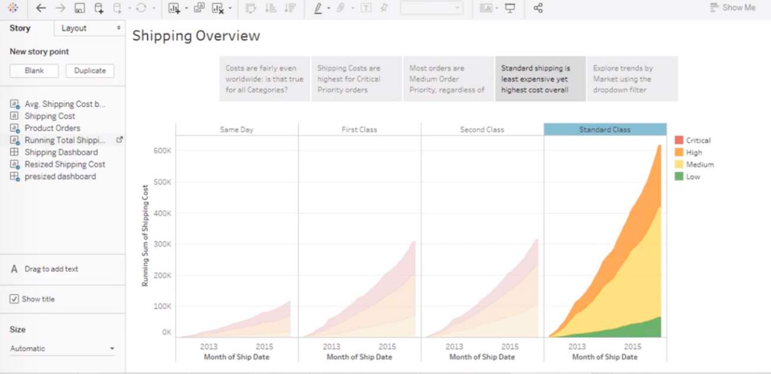

Slide 21
MAPPING
EDITING LOCATIONS
SPATIAL FILES
CUSTOM GEOCODING
POLYGON MAPS

Slide 22
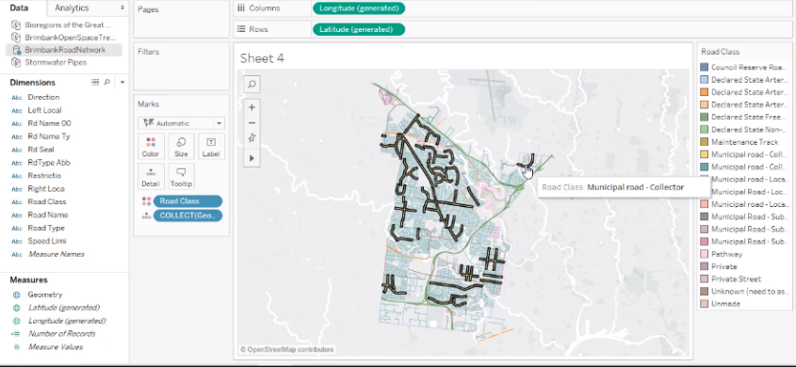

Slide 23
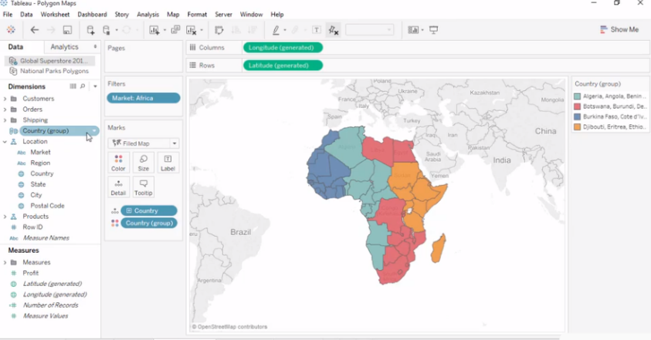

Slide 24
CALCULATIONS
DATE(datediff)
LOGIC(threshold where they follow)
STRING(search of the word , can use filter)
TYPE(size of the word of all)

Slide 25
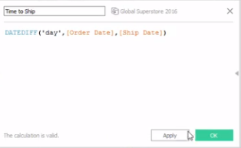
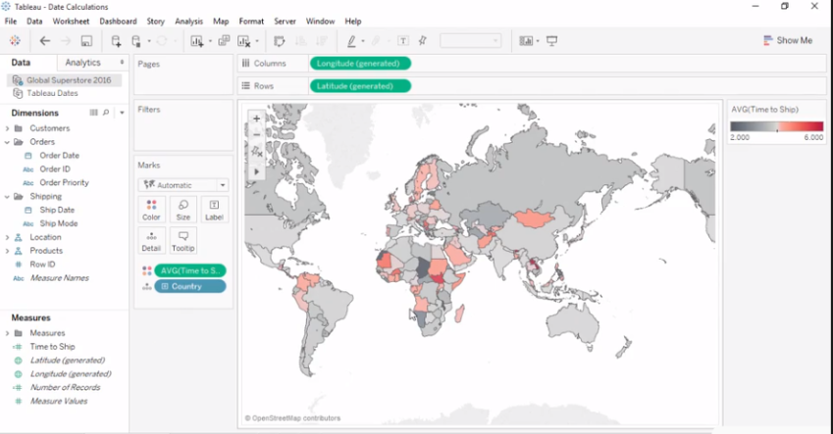

Slide 26
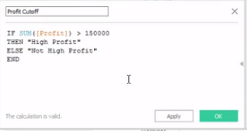
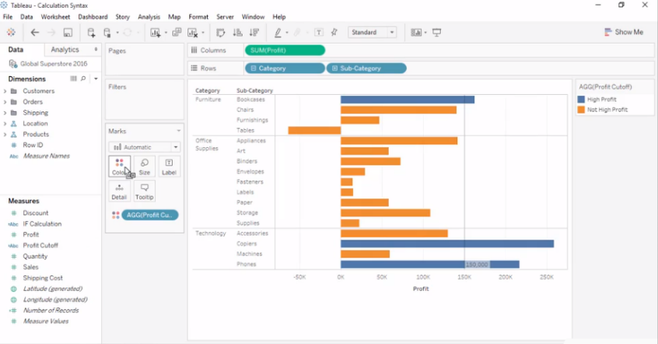

Slide 27
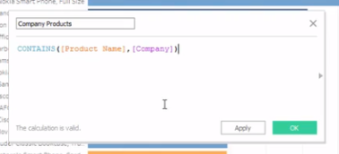
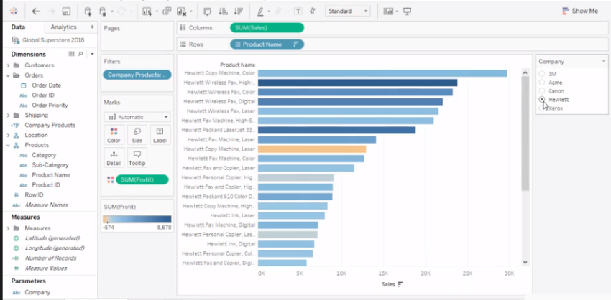

Slide 28
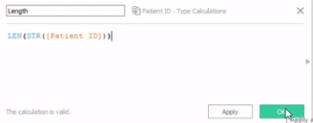
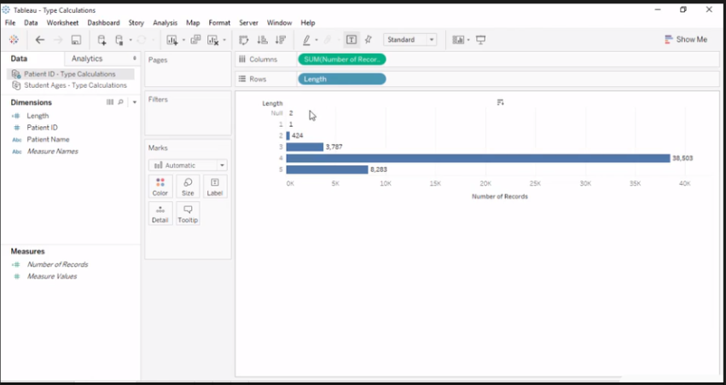

Slide 29
THANK YOU

